Slide 1
Logical Agents
Chapter 7

Slide 2

Knowledge bases
Knowledge base = set of sentences in a formal language
Declarative approach to building an agent (or other system):
Tell it what it needs to know
Then it can Ask itself what to do - answers should follow from the KB
Agents can be viewed at the knowledge level
i.e., what they know, regardless of how implemented
Or at the implementation level
i.e., data structures in KB and algorithms that manipulate them

Slide 3
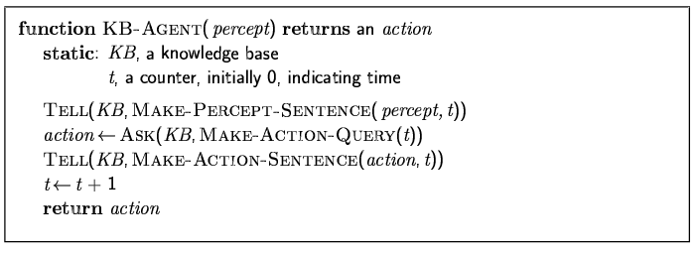
A simple knowledge-based agent
The agent must be able to:
Represent states, actions, etc.
Incorporate new percepts
Update internal representations of the world
Deduce hidden properties of the world
Deduce appropriate actions

Slide 4
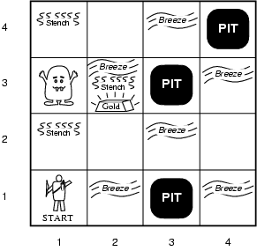
Wumpus World PEAS description
Performance measure
gold +1000, death -1000
-1 per step, -10 for using the arrow
Environment
Squares adjacent to wumpus are smelly
Squares adjacent to pit are breezy
Glitter iff gold is in the same square
Shooting kills wumpus if you are facing it
Shooting uses up the only arrow
Grabbing picks up gold if in same square
Releasing drops the gold in same square
Sensors: Stench, Breeze, Glitter, Bump, Scream
Actuators: Left turn, Right turn, Forward, Grab, Release, Shoot

Slide 5
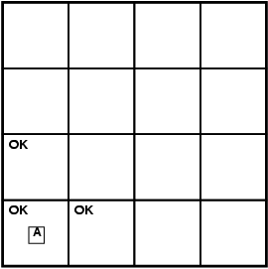
Exploring a wumpus world

Slide 6
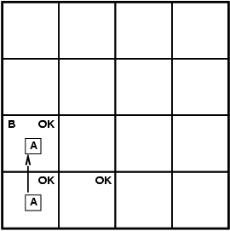
Exploring a wumpus world

Slide 7
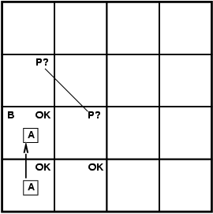
Exploring a wumpus world

Slide 8
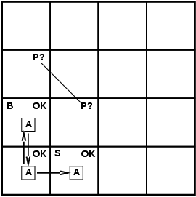
Exploring a wumpus world

Slide 9
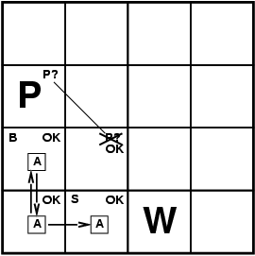
Exploring a wumpus world

Slide 10

Exploring a wumpus world

Slide 11
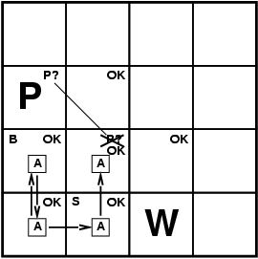
Exploring a wumpus world

Slide 12
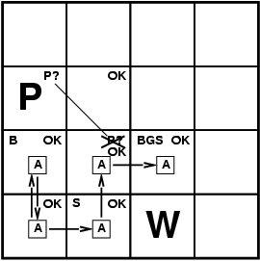
Exploring a wumpus world

Slide 13
Logic in general
Logics are formal languages for representing information such that conclusions can be drawn
Syntax defines the sentences in the language
Semantics define the "meaning" of sentences;
i.e., define truth of a sentence in a world
E.g., the language of arithmetic
x+2 ≥ y is a sentence; x2+y > {} is not a sentence
x+2 ≥ y is true iff the number x+2 is no less than the number y
x+2 ≥ y is true in a world where x = 7, y = 1
x+2 ≥ y is false in a world where x = 0, y = 6

Slide 14
Entailment
Entailment means that one thing follows from another:
KB ╞ α
Knowledge base KB entails sentence α if and only if α is true in all worlds where KB is true
E.g., the KB containing “the Giants won” and “the Reds won” entails “Either the Giants won or the Reds won”
E.g., x+y = 4 entails 4 = x+y
Entailment is a relationship between sentences (i.e., syntax) that is based on semantics

Slide 15
Inference
KB ├_{i} α = sentence α can be derived from KB by procedure i
Soundness: i is sound if whenever KB ├_{i} α, it is also true that KB╞ α
Completeness: i is complete if whenever KB╞ α, it is also true that KB ├_{i} α
Preview: we will define a logic (first-order logic) which is expressive enough to say almost anything of interest, and for which there exists a sound and complete inference procedure.
That is, the procedure will answer any question whose answer follows from what is known by the KB.

Slide 16
Propositional logic: Syntax
Propositional logic is the simplest logic – illustrates basic ideas
The proposition symbols P₁, P₂ etc are sentences
If S is a sentence, ¬S is a sentence (negation)
If S₁ and S₂ are sentences, S₁ ∧ S₂ is a sentence (conjunction)
If S₁ and S₂ are sentences, S₁ ∨ S₂ is a sentence (disjunction)
If S₁ and S₂ are sentences, S₁ ⇒ S₂ is a sentence (implication)
If S₁ and S₂ are sentences, S₁ ⇔ S₂ is a sentence (biconditional)

Slide 17
Propositional logic: Semantics
Each model specifies true/false for each proposition symbol
E.g. P_{1,2} P_{2,2} P_{3,1}
false true false
With these symbols, 8 possible models, can be enumerated automatically.
Rules for evaluating truth with respect to a model m:
¬S is true iff S is false
S₁ ∧ S₂ is true iff S₁ is true and S₂ is true
S₁ ∨ S₂ is true iff S₁is true or S₂ is true
S₁ ⇒ S₂ is true iff S₁ is false or S₂ is true
i.e., is false iff S₁ is true and S₂ is false
S₁ ⇔ S₂ is true iff S₁⇒S₂ is true andS₂⇒S₁ is true
Simple recursive process evaluates an arbitrary sentence, e.g.,
¬P_{1,2} ∧ (P_{2,2} ∨ P_{3,1}) = true ∧ (true ∨ false) = true ∧ true = true

Slide 18
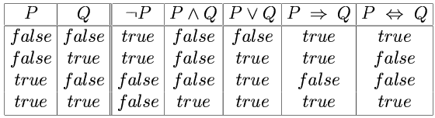
Truth tables for connectives

Slide 19
Forward and backward chaining
Horn Form (restricted)
KB = conjunction of Horn clauses
Horn clause =
proposition symbol; or
(conjunction of symbols) ⇒ symbol
E.g., C ∧ (B ⇒ A) ∧ (C ∧ D ⇒ B)
Modus Ponens (for Horn Form): complete for Horn KBs
α₁, … ,α_{n}, α₁ ∧ … ∧ α_{n} ⇒ β
β
Can be used with forward chaining or backward chaining.
These algorithms are very natural and run in linear time

Slide 20
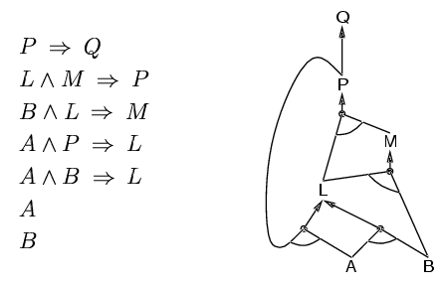
Forward chaining
Idea: fire any rule whose premises are satisfied in the KB,
add its conclusion to the KB, until query is found

Slide 21
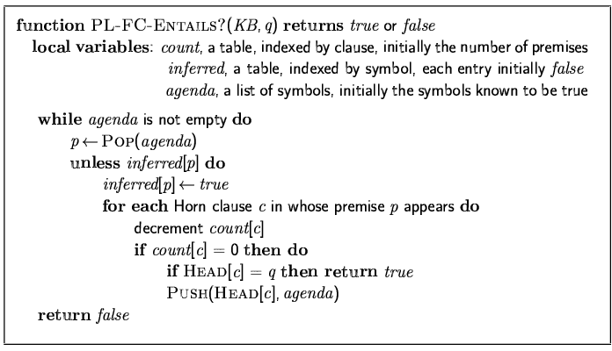
Forward chaining algorithm
Forward chaining is sound and complete for Horn KB

Slide 22
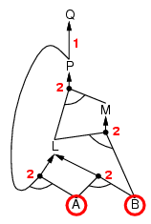
Forward chaining example

Slide 23
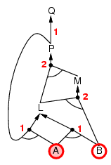
Forward chaining example

Slide 24
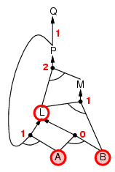
Forward chaining example

Slide 25
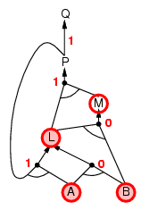
Forward chaining example

Slide 26
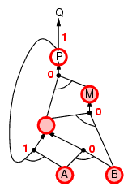
Forward chaining example

Slide 27
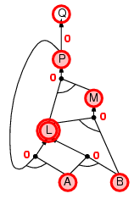
Forward chaining example

Slide 28
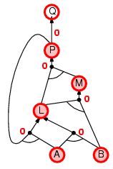
Forward chaining example

Slide 29

Forward chaining example

Slide 30
Proof of completeness
FC derives every atomic sentence that is entailed by KB
FC reaches a fixed point where no new atomic sentences are derived
Consider the final state as a model m, assigning true/false to symbols
Every clause in the original KB is true in m
a₁ ∧ … ∧ a_{k ⇒} b
Hence m is a model of KB
If KB╞ q, q is true in every model of KB, including m

Slide 31
Backward chaining
Idea: work backwards from the query q:
to prove q by BC,
check if q is known already, or
prove by BC all premises of some rule concluding q
Avoid loops: check if new subgoal is already on the goal stack
Avoid repeated work: check if new subgoal
has already been proved true, or
has already failed

Slide 32
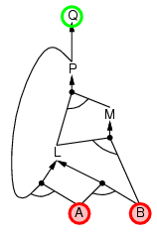
Backward chaining example

Slide 33
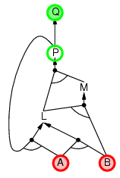
Backward chaining example

Slide 34
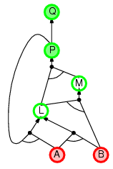
Backward chaining example

Slide 35
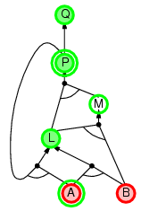
Backward chaining example

Slide 36
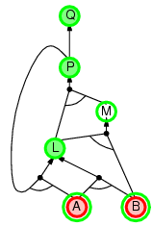
Backward chaining example

Slide 37
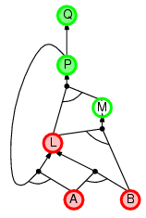
Backward chaining example

Slide 38
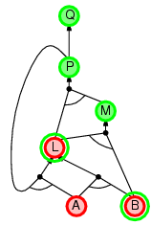
Backward chaining example

Slide 39
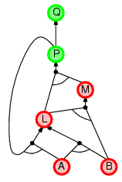
Backward chaining example

Slide 40
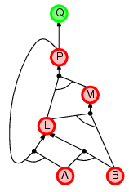
Backward chaining example

Slide 41
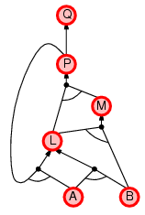
Backward chaining example

Slide 42
Forward vs. backward chaining
FC is data-driven, automatic, unconscious processing,
e.g., object recognition, routine decisions
May do lots of work that is irrelevant to the goal
BC is goal-driven, appropriate for problem-solving,
e.g., Where are my keys? How do I get into a PhD program?
Complexity of BC can be much less than linear in size of KB

